Slide 1
Cybersecurity Awareness
Shane Harkins
Chief Information Officer, CISSP, CCSP

Slide 2

Safe Secure Serve

Slide 3
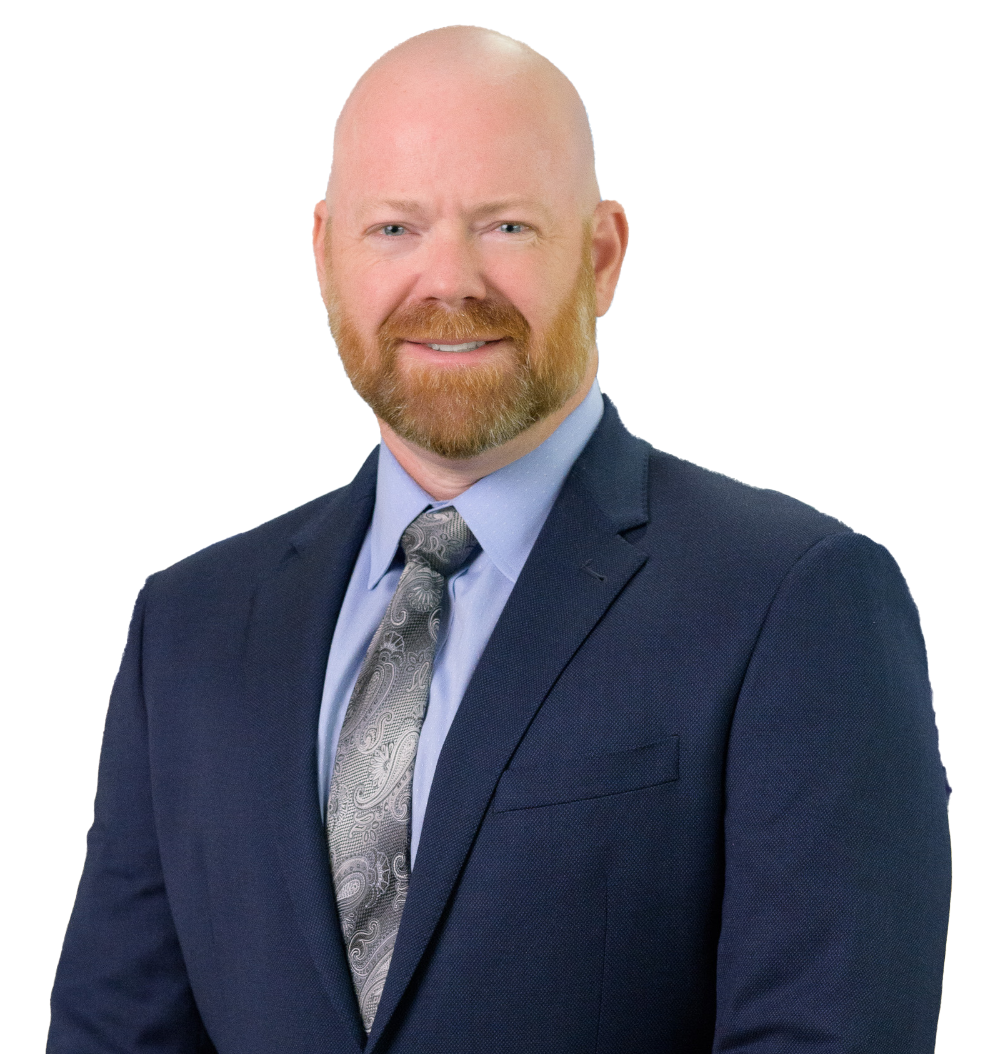
Shane Harkins – Chief Information Officer, NDBT
Bachelor of Science in IT – Security and certifications including CISSP, CCSP, Microsoft, and Cisco
30+ years of technology leadership in financial services, insurance, and wealth management
Leads NDBT’s IT modernization
Known for aligning technology strategy with business goals and strong regulatory performance

Slide 4
But First….
Disclaimer:
The views, thoughts, and opinions expressed in this presentation are solely those of the presenter and do not necessarily reflect the official policy, position, or opinions of NDBT.
While every effort has been made to ensure the accuracy and completeness of the information presented, any errors or omissions are unintentional and the responsibility of the presenter.

Slide 5
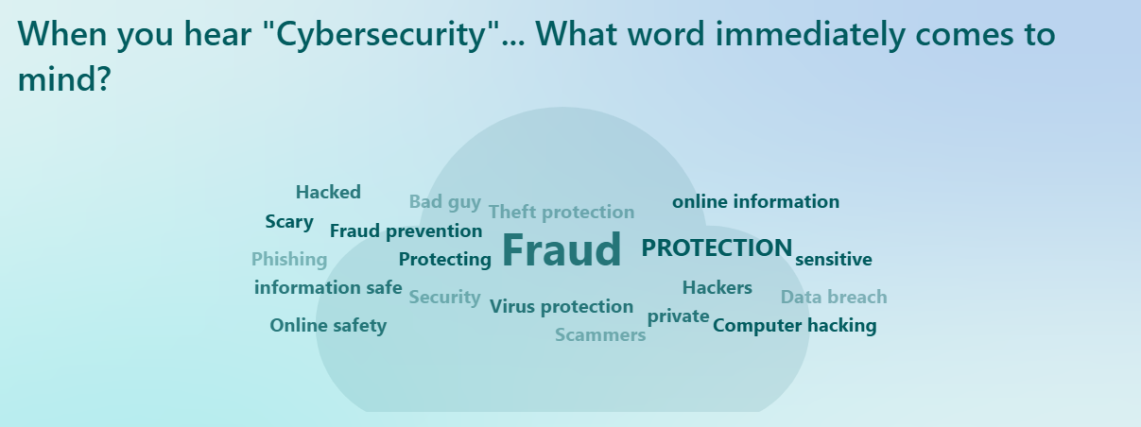
What Does “it” Mean ?
When you hear "Cybersecurity"... What word immediately comes to mind?

Slide 6
Agenda
Phishing
Multi Factor Authentication (MFA)
Artificial Intelligence (A/I)
Scams and Threats
Vulnerability Management Programs

Slide 7
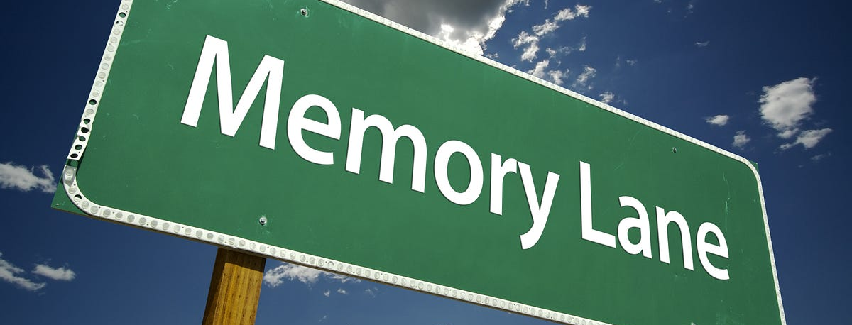
Let’s Take a Stroll…

Slide 8
Memorable / Significant Events
Sony Pictures – Data Breach Poodle vulnerability $15 – $35 Million
2015
2017
Equifax – 147 Million People more than $700 Million in Fines
2007 – 2010
2014
2013 – 2014
Yahoo – Data Breach 3 Billion people – $117 Million
Target Breach, 40 Million people $162 – $202 Million
Ukranian – Power Grid hacked
2018
Marriott / Starwood – 500 Million People – $52 Million
2021
Colonial Pipeline – Ransomware $4.4 Million Ransom
WannaCry – 200,000 computers 150 countries $4 Billion
Log4J – Vulnerability
2013
Stuxnet – Iranian Nuclear enrichment
2023
MGM Resorts - $100 Million 10 – Minutes
2024
Change Healthcare Ransomware –115 Million Americans – $22 Million

Slide 9
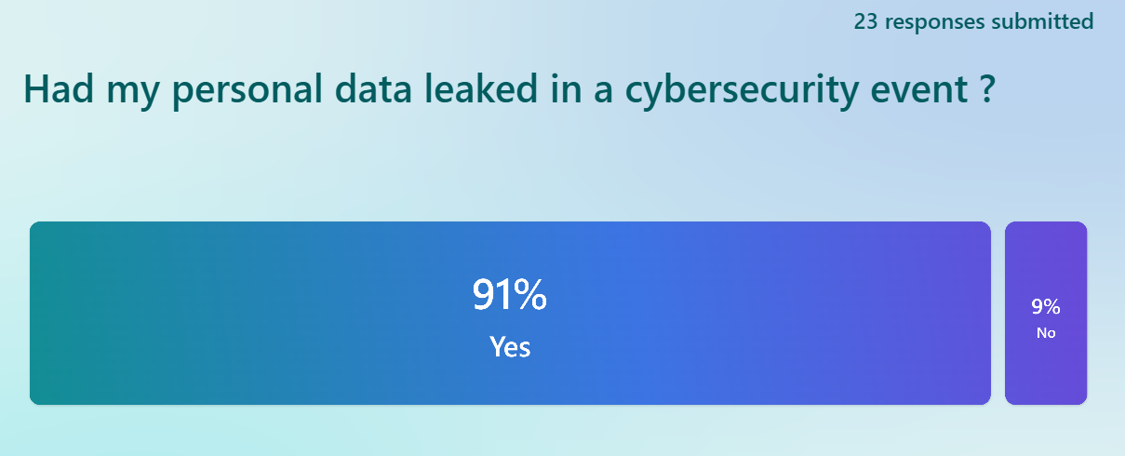
Never Have I Ever…

Slide 10
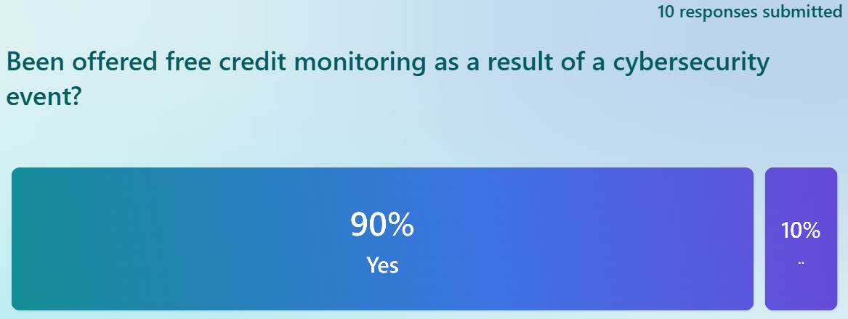
Never Have I Ever…

Slide 11

Phishing

Slide 12
Phishing
A type of cyberattack where attackers impersonate a trustworthy entity to trick individuals into revealing sensitive information
  Spear Phishing: Targeted attacks on specific individuals or organizations.
  Smishing: Phishing via SMS/text messages.
  Vishing: Voice phishing via phone calls.
  Clone Phishing: A legitimate message is copied and altered with malicious content.

Slide 13

Do You Remember ?

Slide 14
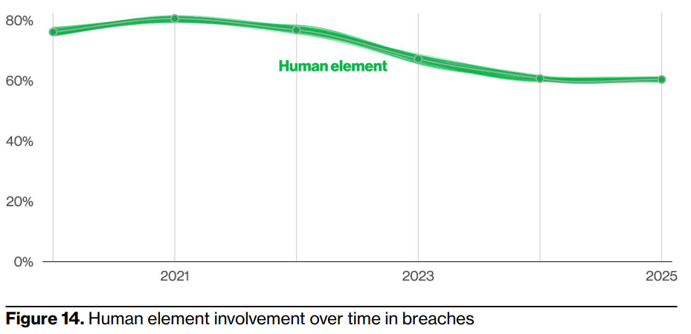
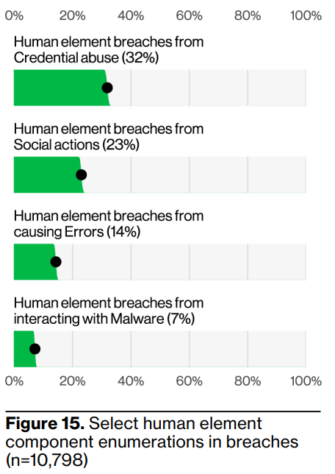
Those Pesky Humans
*Reference: Verizon 2025 DBIR

Slide 15
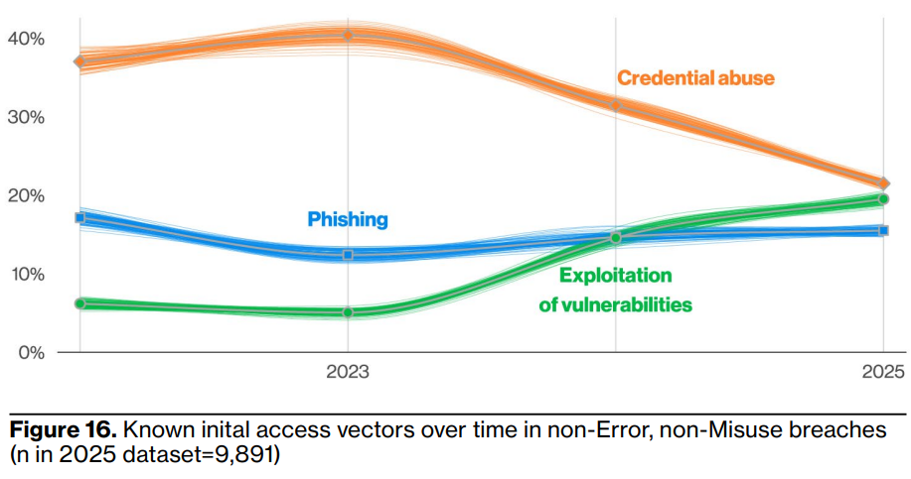
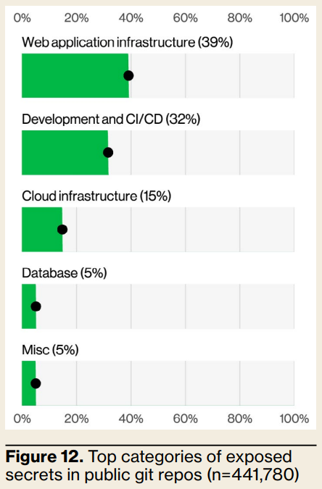
Initial Access Vectors for Breaches
*Reference: Verizon 2025 DBIR

Slide 16

Something “Phishy” is Going on..
Estimated global financial impact = $3.5 Billion
Email = 65% of all phishing attempts
Success rate has climbed to 18%
  Up from 14% in 2023
Reference: Trend Micro – Top 15 Phishing stats to know in 2024

Slide 17
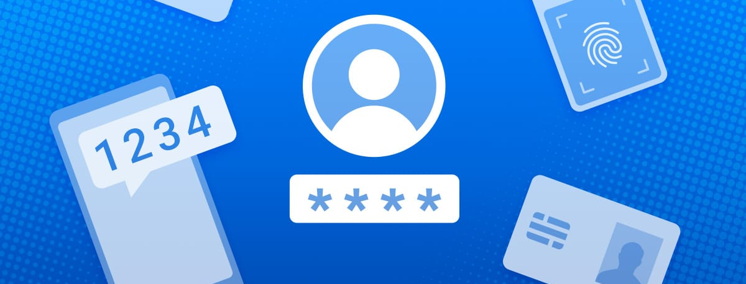
MFA

Slide 18
MFA
Something you know: Password or PIN
Something you have: Phone, security token, smart card
Something you are: Fingerprint, face scan, voice recognition

Slide 19
MFA
Stronger Security than Passwords Alone
Protects Against Phishing and Credential Theft
Reduces Risk of Account Takeover
Compliance and Regulatory Requirements
Safeguards Remote Access
Mitigates Impact of Data Breaches

Slide 20
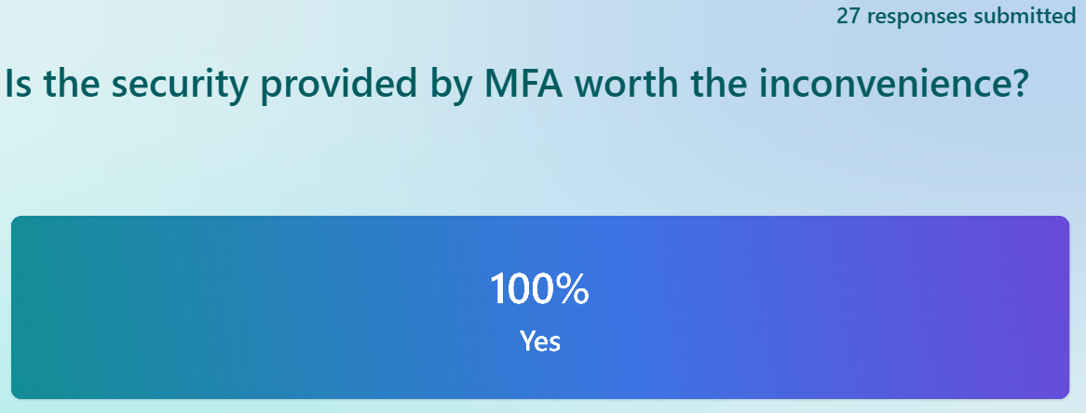
What Do You Think?

Slide 21
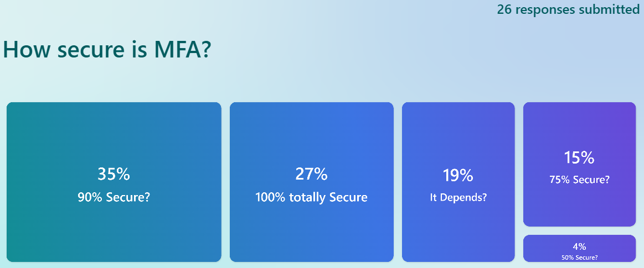
What Do You Think?

Slide 22
It Really Depends..
Why?
Man in the Middle Attacks
Sim Swapping
MFA Bombing
Session Replay attacks

Slide 23
Do it Anyway!
Single greatest improvement in personal security available at scale today
It’s really… not that hard…
It works!

Slide 24
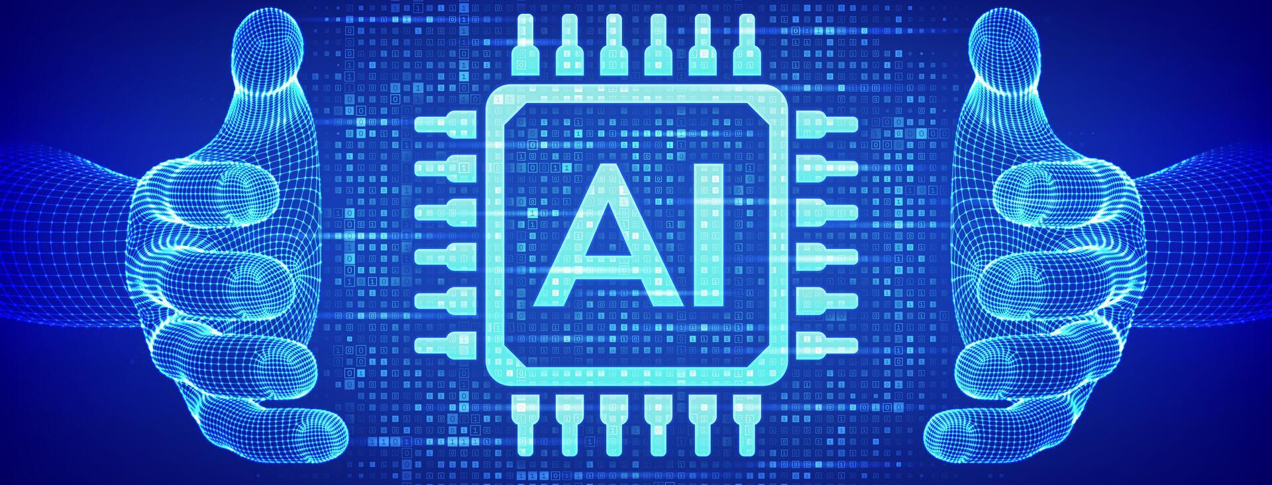
Artificial Intelligence “A/I”

Slide 25
A/I – Rise of the Machines
“A hacker used AI to automate an 'unprecedented' cybercrime spree”
Anthropic, the company behind the Claude chatbot said it caught a hacker using its chatbot to identify, hack and extort at least 17 companies.
Reference: NBC News

Slide 26
What can A/I do for “to” you?
Identify companies vulnerable to attack
Create malicious software used to steal sensitive information
Organize hacked files and analyze to help determine what is sensitive and could be used to extort the victim companies
Analyze the companies’ hacked financial documents to help determine a realistic amount of bitcoin “Ransom” to demand
Write suggested extortion emails

Slide 27

Deep Fakes
$622,000 Zoom Call Scam (China)
Reference: Breacher.AI

Slide 28
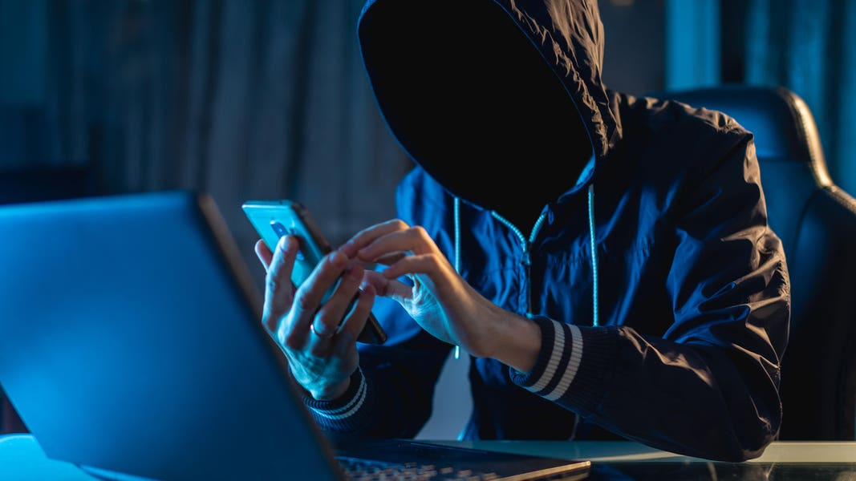
Deep Fakes
€220,000 Voice Clone Fraud at UK Energy Firm
Reference: Breacher.AI

Slide 29
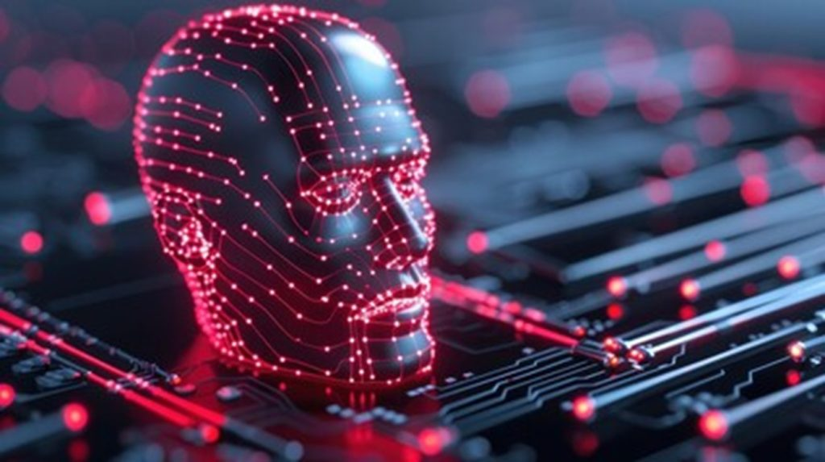
Deep Fakes
$25 Million
CFO Impersonation
Reference: CFO.com

Slide 30
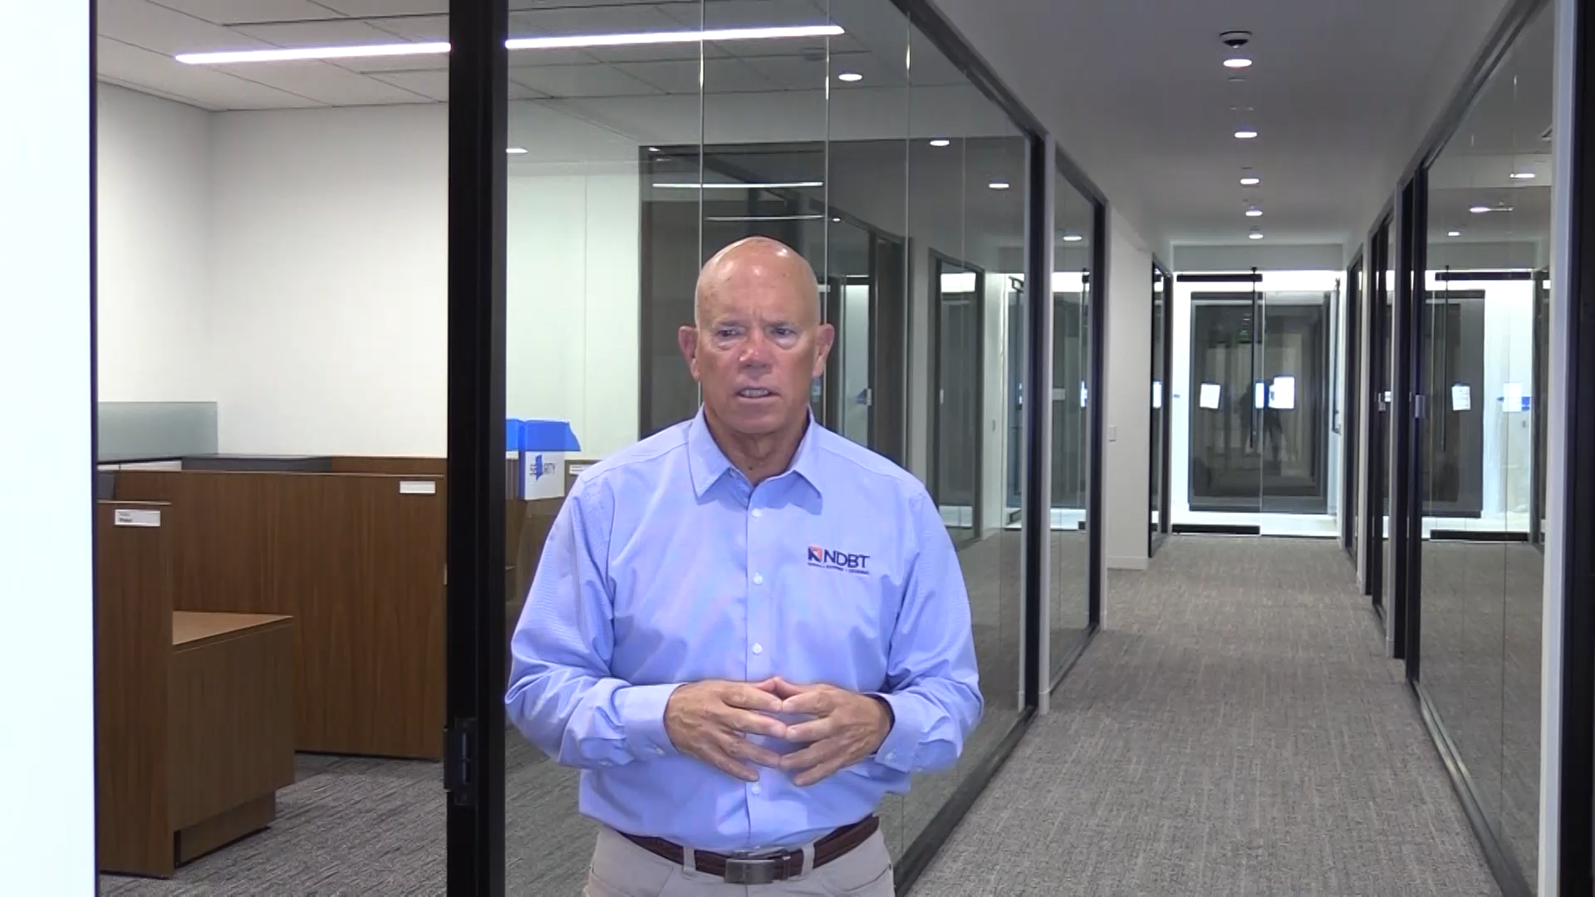
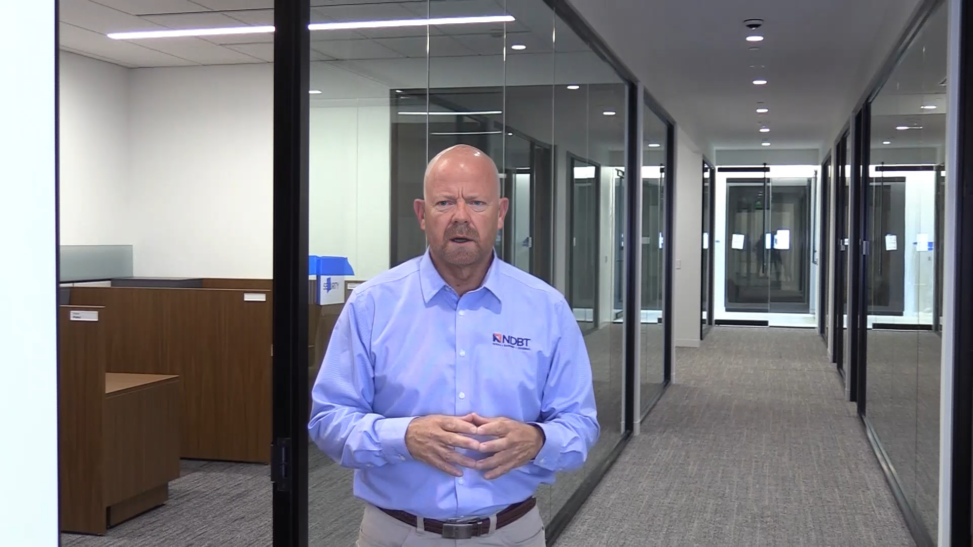
"Believe nothing you hear, and only half of what you see.“ Edgar Allan Poe ?
Original
Edited

Slide 31
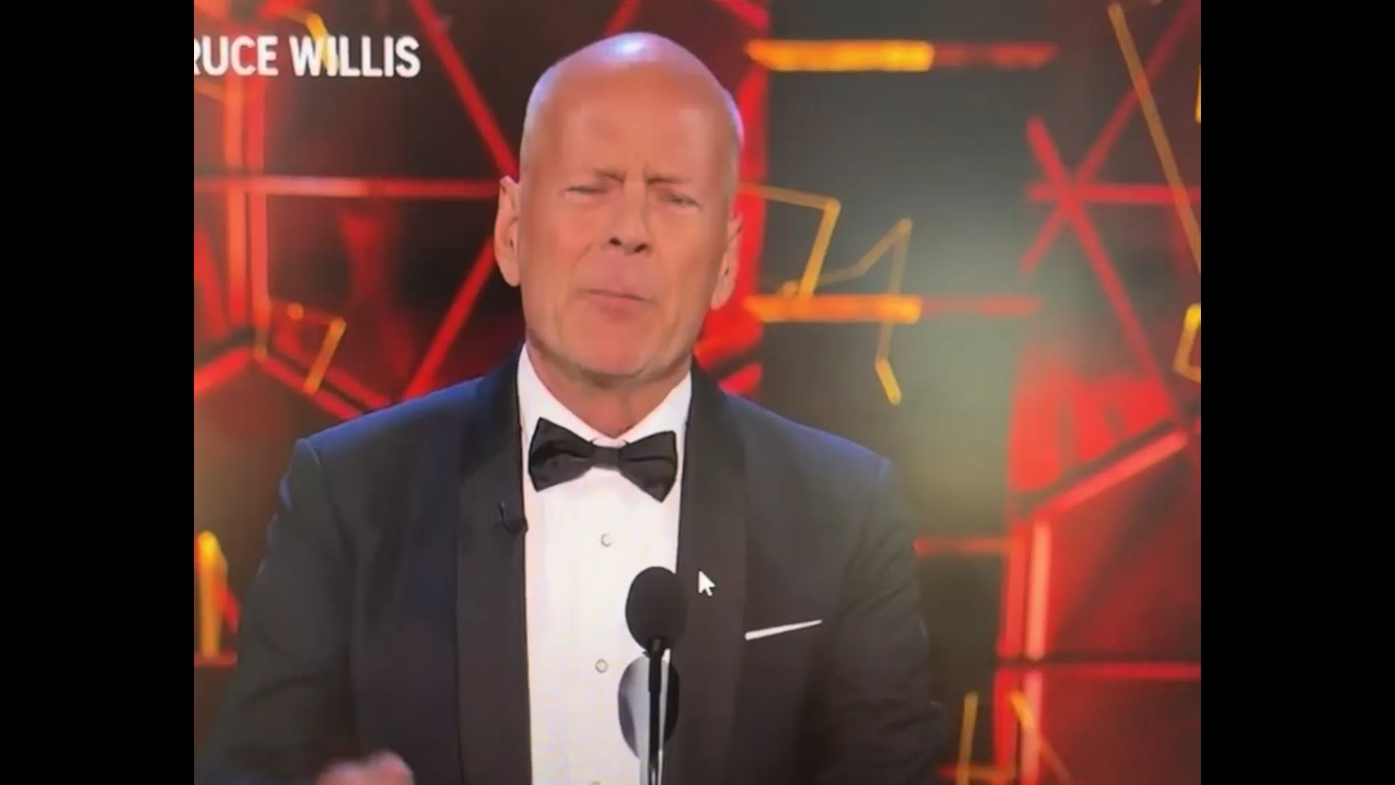
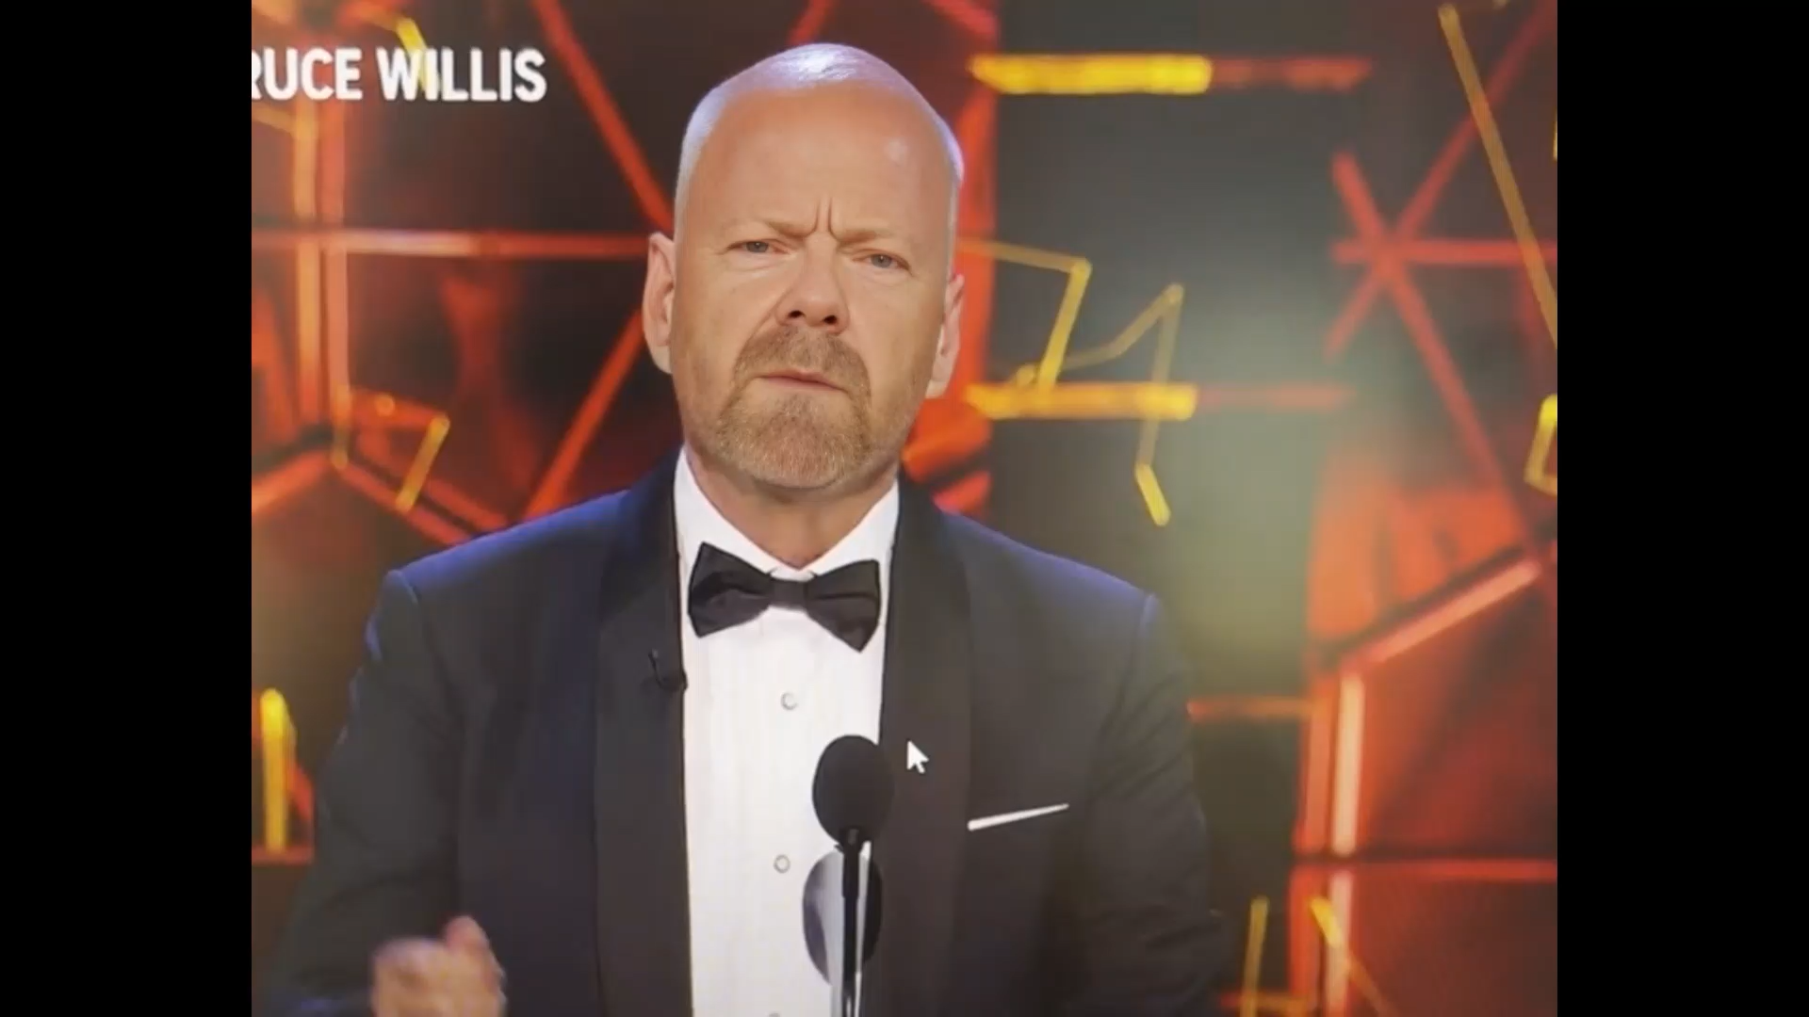
"Believe nothing you hear, and only half of what you see.“ Edgar Allan Poe ?
Original
Edited

Slide 32
Too Easy
Committed 1 Hour
ROOP utility
Google Colab Environment
  6 Min “Face Swap”
  4 Min Enhance the lighting effect
  5 Min to render the compiled video
Total cost to produce: FREE!

Slide 33

Scams and Threats

Slide 34
Current Scams and Threats
In our Community
  Fake Technical Support Scams (PayPal, Zelle, Fraud Departments)
  Romance Scams
  Crypto Investment scams
In the Wild
  Deepfake A/I driven family in perils scams

Slide 35
Current Scams and Threats
“For Sale / Hot Deal”
Someone you “Know”
“Accidental” payment
You’ve Won!

Slide 36
Vulnerability Management Program
IDENTIFY
PATCH
SCAN
ANALYZE
MITIGATE & REMEDIATE
VERIFY

Slide 37
Vulnerability Management Program
Asset Inventory
Vulnerability Scanning
Risk Assessment
Remediation
Verification
Reporting & Documentation
Continuous Improvement

Slide 38
Resources
Verizon 2025 Data Breach Investigation Report
  https://www.verizon.com/business/resources/Te2f/reports/2025-dbir-data-breach-investigations-report.pdf
Trend Micro – Top 15 Phishing stats to know in 2024
  https://news.trendmicro.com/2024/07/22/phishing-stats-2024/
Mandiant – reports
  https://cloud.google.com/security/resources/m-trends
  https://cloud.google.com/security/resources/cybersecurity-forecast

Slide 39
Resources
CISA Cyber Threats and Advisories
  https://www.cisa.gov/topics/cyber-threats-and-advisories
2024 Report on the Cybersecurity Posture of the United States
  2024-Report-on-the-Cybersecurity-Posture-of-the-United-States.pdf
U.S. Government Accountability Office (GAO)
  https://www.gao.gov/cybersecurity
2023 NSA Cybersecurity Year in Review
  https://media.defense.gov/2023/Dec/19/2003362479/-1/-1/0/NSA_Cybersecurity_YiR23_Book_508.PDF

Slide 40
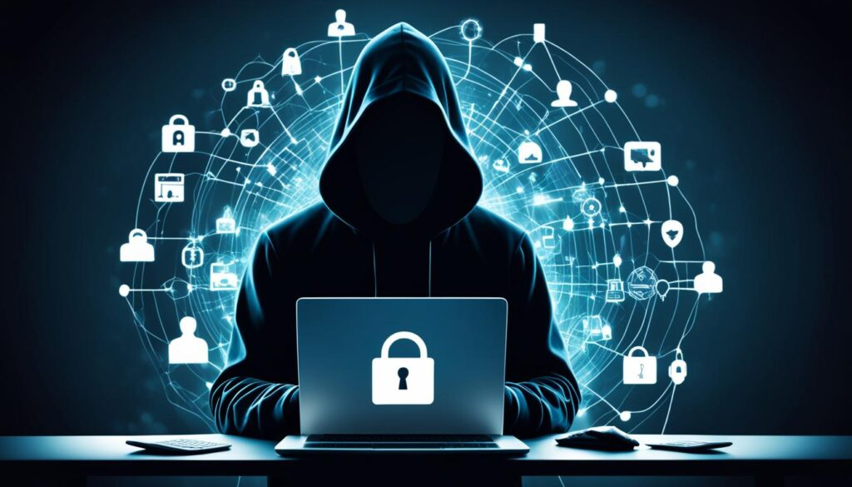
Questions
?

Slide 41

NDBT Cybersecurity Resources
https://ndbt.com/cybersecurity/

